Slide 1
形式语言与自动机理论 课程介绍
李钦 副教授
华东师范大学
软件工程学院

Slide 2
课程简介
课程内容
课程对象
课程安排和考核方式

Slide 3
what
Introduction to Automata Theory
Finite state automata
Pushdown automata
Turing Machine
Introduction to Formal Language
Regular language
Context-free language
Recursively enumerable language
Properties about them

Slide 4
why
Familiar with these concepts will make you a better computer scientist
It allow us to use mathematics to solve problems arising from computers
It is required if you are interested in a research career in Computer Science
It distinguishes you from someone who has picked up programming at a technique school
It gives exposure to some of the absolute highpoints of human thought
It gives a nice setting for improving your problem solving skills

Slide 5
Who
Research
Theory of Software Engineering
Computation Algorithms
Engineering
Programming language Selection
Model Driven Development
Preliminary: Discrete mathematics
Set theory
Predicate logics
Programming experience

Slide 6
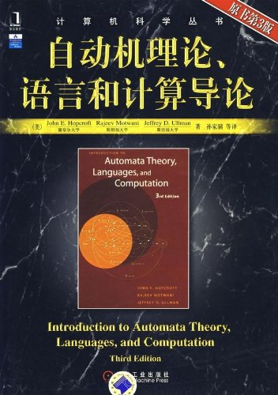
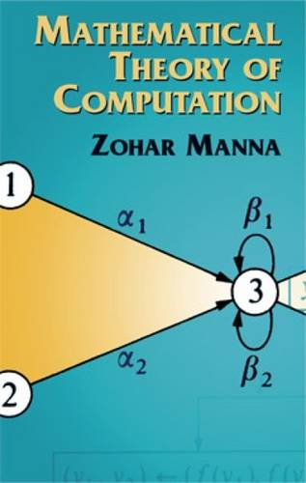
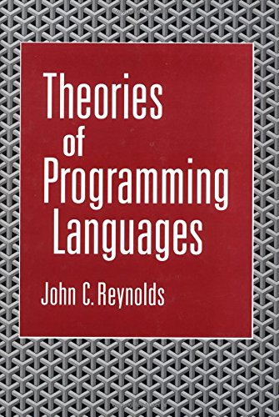
参考书目
John E. Hopcroft, Rajeev Motwani, Jeffrey D. Ullman. Introduction to Automata Theory, Languages, and Computation.
Zohar Manna. Mathematical Theory of Computation.
John C. Reynolds. Theories of Programming Languages.

Slide 7
课程安排
Preliminary 1 sessions (Set theory, Predicate logic)
Automata Theories 6 sessions (Finite Automata, Pushdown Automata, Turing machines)
Formal Languages 6 sessions (RL, CFL, REL)
Properties and Proofs 4 sessions

Slide 8
考核方式
期末考查 60%
平时成绩 40%
考勤 20%
作业 20%

Slide 9
联系方式
李钦
理科楼B1001
Tel: 62233019
Email: qli@sei.ecnu.edu.cn

